Slide 1
Services
Spencer Schneidenbach

Slide 2
What are Services?
Services are best used to create, read, update and delete data
Enforces separation of concerns
Think of it like this: you don’t want your database in your view!

Slide 3
Services in Angular 1
In Angular 1, we had 5 different kinds of services:
Provider
Service
Factory
Value
Constants
In Angular 2, we have 1 kind of service:
Service
Which do you prefer?

Slide 4
Guess what? A service is just a class
Are you surprised?

Slide 5
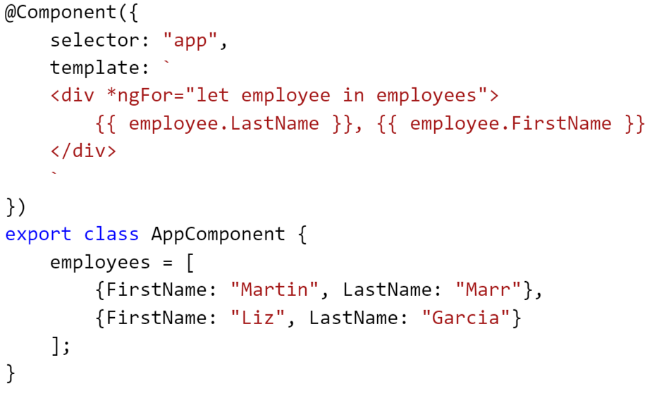
Ready for refactoring

Slide 6
Steps to declaring and using a service
Write your class and add some data to it
Import Injectable and decorate your service class with it
Import the service in your component
Add the service to the component providers
Add it to the component as a property and in the constructor

Slide 7
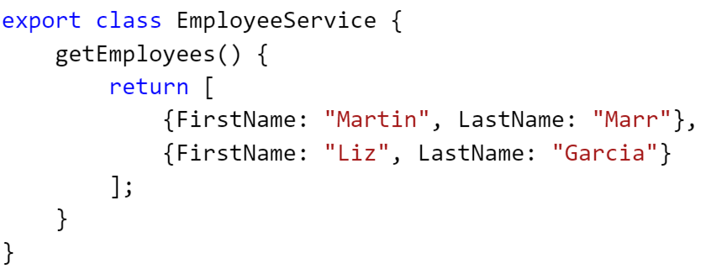
Step 1 – Make class with data

Slide 8
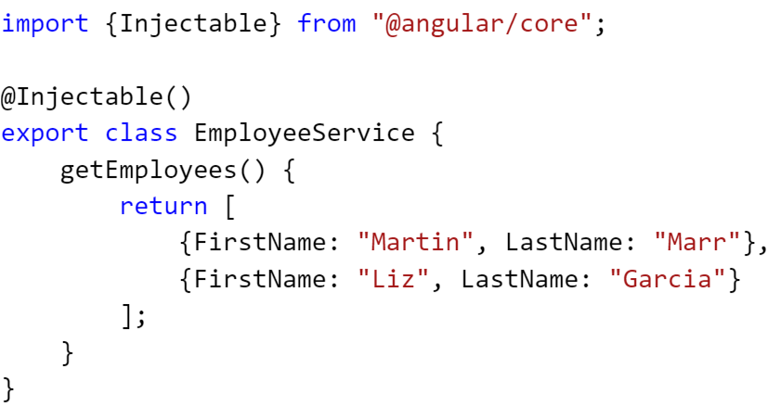
Step 2 – Import @Injectable and decorate

Slide 9
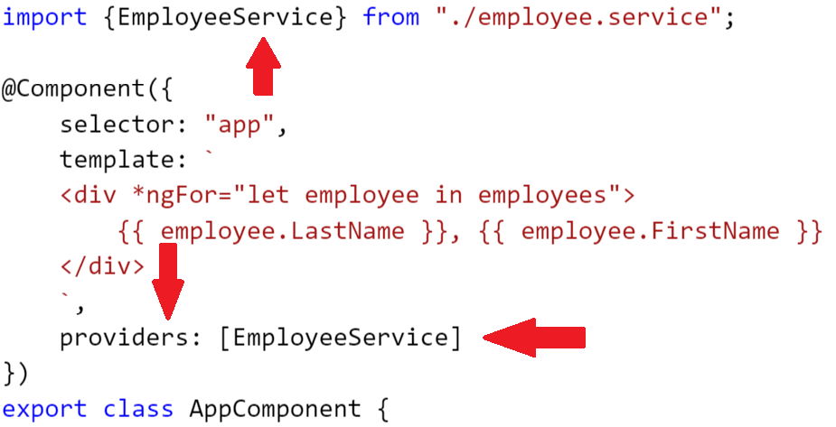
Steps 3 and 4 – Import and register

Slide 10
This is dependency injection
Sound familiar from Angular 1? Yep, it’s still here
A single instance will flow from parent down to child if the child requests an instance in its constructor
Dependencies are auto-resolved – if one service is dependent on another, the “parent” service will be injected into the dependent service
Allows for modularity and better testing

Slide 11
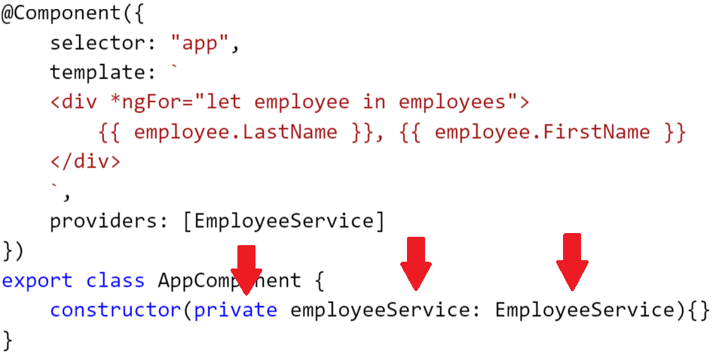
Step 5 – Add as property and to constructor

Slide 12
Hey wait a second…

Slide 13
Good time todddd introduce… Lifecycle hooks!ddd
Lifecycle hooks allow us to run code after a component is created and/or destroyed
Focusing on two:
OnInit
OnDestroy
But really only one:
OnInit

Slide 14
OnInit
OnInit – run right after a component is constructed
If a component has the “ngOnInit” function on it, the OnInit lifecycle hook will execute
There’s also a helpful interface that tells you that you haven’t implemented it yet if you mean to implement it

Slide 15
Step 1: Import OnInit

Slide 16
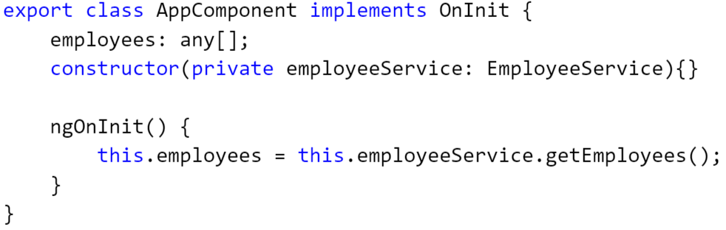
Step 2: Implement

